Slide 1
Pods

Slide 2
Pods Introduction
Automate container deployment,scaling & management

Slide 3
Pod Overview
Pod is a group of containers.
It is the smallest unit that can be scheduled to be deployed through K8s.
Normally a microservices is provided by this tightly coupled group of containers.
This groups of containers would share storage, Linux namespaces, cgroups, IP addresses.
These are co-located, hence share resources and are always scheduled together.
Created, destroyed and re-created on demand, based on the state of the server and the service itself.

Slide 4
Collection of PODS
A pod never spans two nodes
Container
Container 1
Container 1
Container 1
Container 1
Container 2
Container 2
Container 2
Pod 3
Pod 1
IP: 10.1.0.1
Pod 2
IP: 10.1.0.2
Pod 4
IP: 10.1.1.2
Pod 5
IP: 10.1.1.3
Node 1
Node 2
All containers of a pod run on the same node

Slide 5
Pod Concept
Containers in a pod run in the same Network namespace, they share the same IP address and port space.
Containers of the same pod need to take care not to bind to the same port numbers or they’ll run into port conflicts
Containers of different pods can never run into port conflicts, because each pod has a separate port space

Slide 6
Why one container per Pod?
Containers are designed to run only a single process per container (unless the process itself spawns child processes).
...and pods are designed to run single container unless very necessary.
If you run multiple unrelated processes in a single container/pod:
Your responsibility to keep all those processes running, manage their logs, and so on.
You’d have to include a mechanism for automatically restarting processes if they crash.
All those processes would log to the same standard output, so you’d have a hard time figuring out what process logged what.
Kubernetes can not scale containers can scale only pods

Slide 7
Why multiple containers per Pod?
Main reason to put multiple containers into a single pod is when the application consists of one main process and one or more complementary processes.
For example:
The main container in a pod could be a web server that serves files from a certain directory, while an additional container (a sidecar container) periodically downloads content from an external source and stores it in the web server’s directory.
Sidecar Containers for log rotators and collectors, data processors, communication adapters, and others.
Main Container
Supporting Container 1
Volume
Supporting Container 2

Slide 8
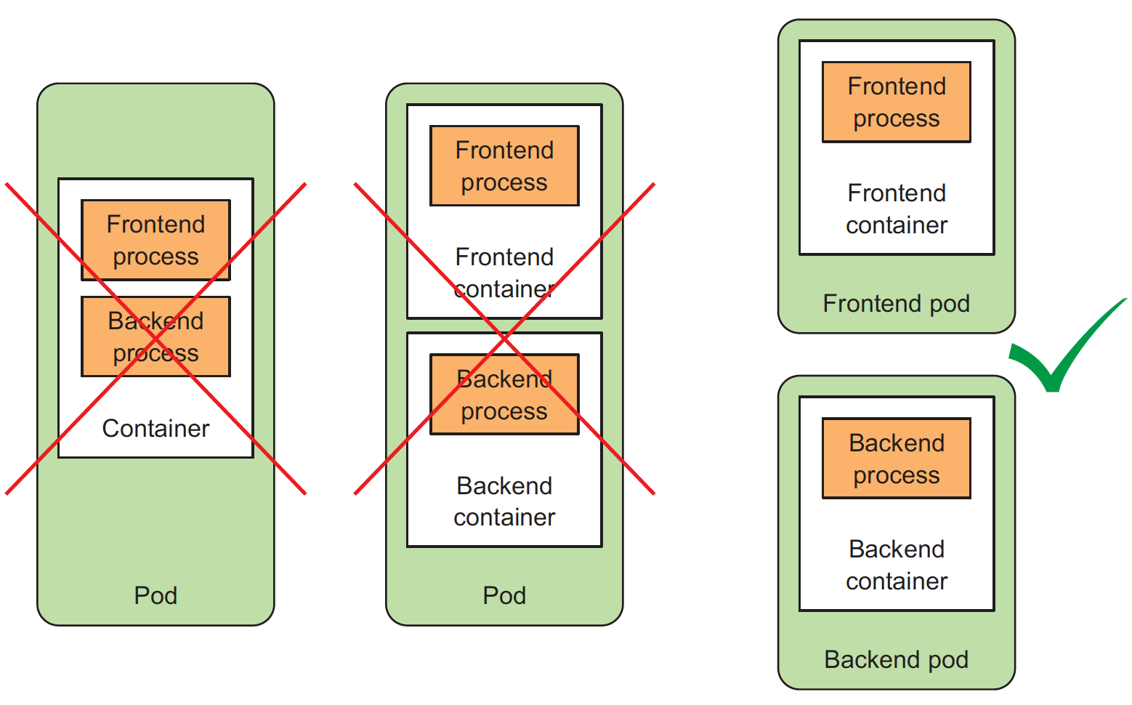
When to use multiple containers in a POD?
one container per po
When deciding whether to put two containers into a single pod or into two separate pods, you always need to ask yourself the following questions:
Do they need to be run together or can they run on different hosts?
Do they represent a single whole or are they independent components?
Must they be scaled together or individually?

Slide 9
Pod - YAML
apiVersion: v1
kind: Pod
metadata:
name: mydemo-pod
labels:
app: myapp
type: front-end
spec:
containers:
- image: nginx-container
name: nginx
ports:
- containerPort: 8080
protocol: TCP
kubectl explain pods
kubectl explain pod.spec
mydemo-pod.yaml
Kubernetes API version used
in this YAML descriptor
Type of Kubernetes object/resource
Pod metadata (name, labels, annotations, and so on)
Pod specification/contents (list of pod’s containers,ports,volumes, so on)
Kind | Version
POD | v1
Service | v1
ReplicaSet | apps/v1
Depplyment | apps/v1

Slide 10
Pod details
Run: kubectl apply –f pod_name.yml
Get info from pod kubectl get po pod_name -o yaml
Metadata includes the name, namespace, labels, and other information about the pod.
Spec contains the actual description of the pod’s contents, such as the pod’s containers, volumes, and other data.
Status contains the current information about the running pod, such as what condition the pod is in, the description and status of each container, and the pod’s internal IP and other basic info.
Kubernetes reference documentation at
https://kubernetes.io/docs/reference/generated/kubernetes-api/v1.18/

Slide 11
Command Reference
Using kubectl create to create the pod
kubectl create -f kubia-manual.yaml
Retrieving the whole definition of a Running POD in YAML/JSON format
kubectl get po kubia-manual -o yaml
kubectl get po kubia-manual -o json
See the newly created POD
kubectl get pods
See the full details 0f POD
kubectl describe pod kubia-manual
View the application logs
docker logs <container id>
Retrieve a POD’s log
Kubectl logs kubia-manual
Retrieve logs when there are multi-container POD
Kubectl logs kubia-manual -c kubia

Slide 12
Lab: Pods YAML

Slide 13
Pod Networking
Communication between Pods on same node
Node
POD 1
IP: 10.244.1.3
POD 2
IP: 10.244.1.4
eth0
eth0
veth1d1
veth542
Bridge 10.244.1.1/24
A virtual ethernet interface is created for the container: one for node’s namespace and one for the container’s network namespace.

Slide 14
Pod Networking
Communication between Pods on different nodes
Node 1
Node 2
POD 1
IP: 10.244.1.3
POD 2
IP: 10.244.2.6
veth
veth
eth0
Bridge
eth0
eth0
Bridge
eth0
Network
The source IP of the pod changes when it’s communicating from node to node

Slide 15
Command Reference
See which node our pod is running:
kubectl get pods -o wide
Log in to the node:
ssh [node_name]
View the node's virtual network interfaces:
ifconfig
View the containers in the pod:
docker ps
Get the process ID for the container:
docker inspect --format '{{ .State.Pid }}' [container_id]
Use nsenter to run a command in the process's network namespace:
nsenter -t [container_pid] -n ip addr

Slide 16
Lab: Pod Networking

Slide 17
Pod: port forwarding
When you want to talk to a specific pod without going through a service (for debugging or other reasons), Kubernetes allows you to configure port forwarding to the pod.
This is done through the kubectl port-forward command.
kubectl port-forward kubia-manual 8888:8080
curl localhost:8888
Port 8888
Port 8080
curl
kubectl port-forward process
Pod: kubia-manual
Local Machines
Kubernetes Cluster

Slide 18
Lab: Pod port-forwarding

Slide 19



Slide 20
Labels & Selectors
Organizing the Objects in Kubetnetes

Slide 21
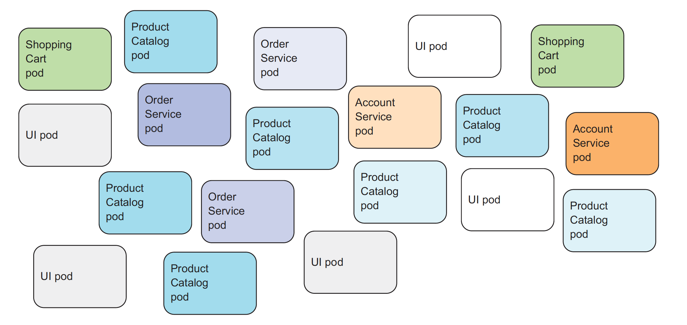
Example:Uncategorized product catalog microservice
Uncategorized pods in a microservices architecture

Slide 22
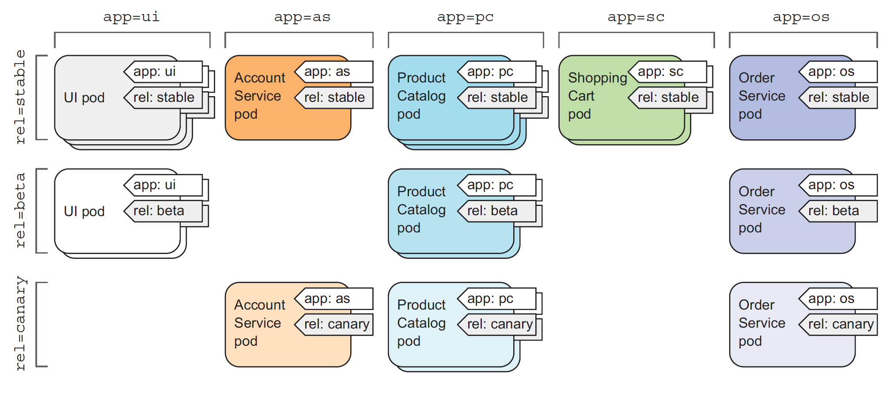
Example: Categorized product catalog microservice
Categorized pods in a microservices architecture with pod labels

Slide 23
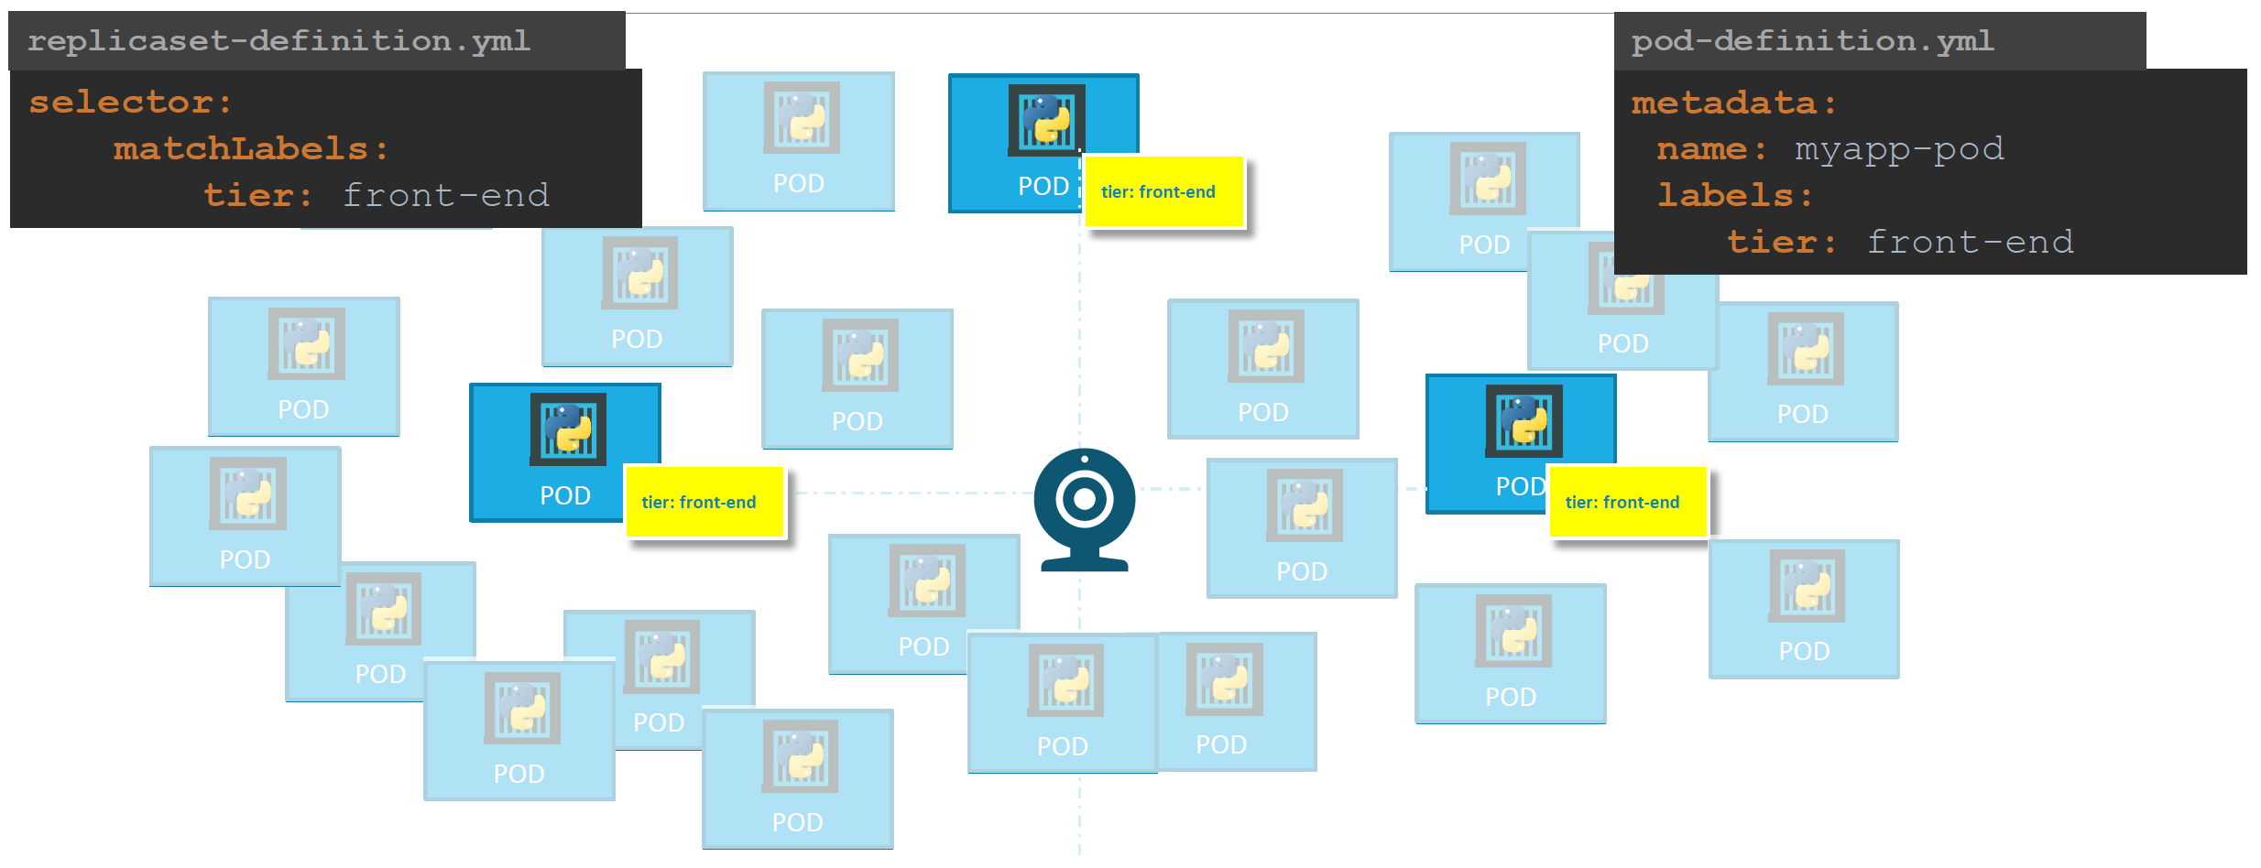
Labels & Selector: Example

Slide 24
Why do we label our PODs and objects in kubernetes?
Labels are key/value pairs that are attached to objects, such as pods.
Labels are intended to be used to identifying the attributes of objects that are meaningful and relevant to users.
Labels can be used to organize and to select subsets of objects.
Labels can be attached to objects at creation time and subsequently added and modified at any time. Each object can have a set of key/value labels defined.
Each Key must be unique for a given object.
Every developer or ops person with access to cluster can easily see the system’s structure and where each pod fits in by looking at the pod’s labels.

Slide 25
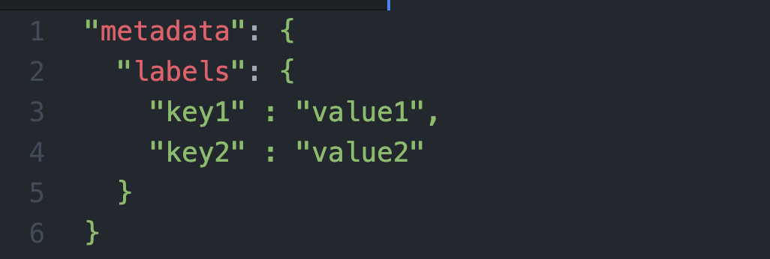
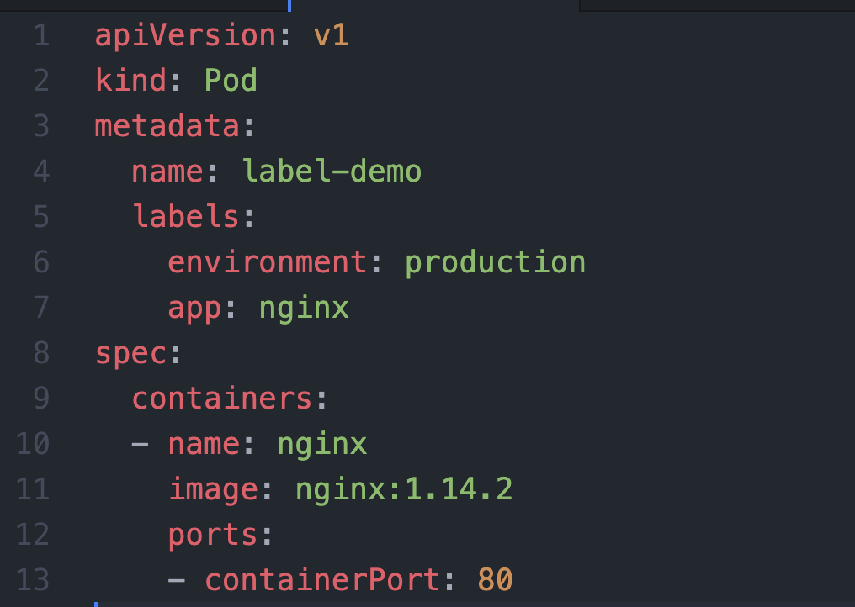
Labels & Selectors

Slide 26
Command Reference
--show-labels option that output the labels of an object
kubectl get pods [pod-name] --show-labels
add a label to the pod
kubectl label pods [pod-name] key=value
To use a label for filtering, for example to list only pods that have an owner that equals michael, use the --selector option
kubectl get pods --selector key=value
kubectl get pods --selector owner=shivam
The --selector option can be abbreviated to -l, so to select pods that are labelled with env=development, do:
kubectl get pods -l key=value
List all pods that are either labelled with env=development or with env=production
kubectl get pods -l 'env in (production, development)'
Remove pods with label selection
kubectl delete pods -l 'env in (production, development)'

Slide 27
Lab: Labels & Selectors

